Slide 1

Sync+ 2.0
Phase4_MY23 U554_R05 HF1_Baidu
Baidu
Updated on 2022-09-26
Desired Outcome
Awareness
Decision
Escalation Help
Think
Point of view
Plan to Implement
Implement

Slide 2
{MY23 U554_R05 HF1} Software overall status {Green}
Software key info
Refer SWAD for the details:
MCU version: 20220909_527_PRO
SOC User version: 20220915_0792_D2L13_R05.PRO.HF1
Verification scope and method:
{Full verification} executed with pass rate 98%, 0 P1 and 0 P2 issues found and not fixed. Refer test report for detail.
Main changes compared with previous version, refer RN for the details, highlights listed below:
Open AIMS with risk evaluation – refer slide 3
Memory leak, VR project test – refer slide 4、5、6
Performance test – refer slide 7
Notes:
Add P1 weekly burn down chart

Slide 3
{MY23 U554_R05 HF1} Open AIMS with risk evaluation
NA
Notes:
Add P1 weekly burn down chart

Slide 4
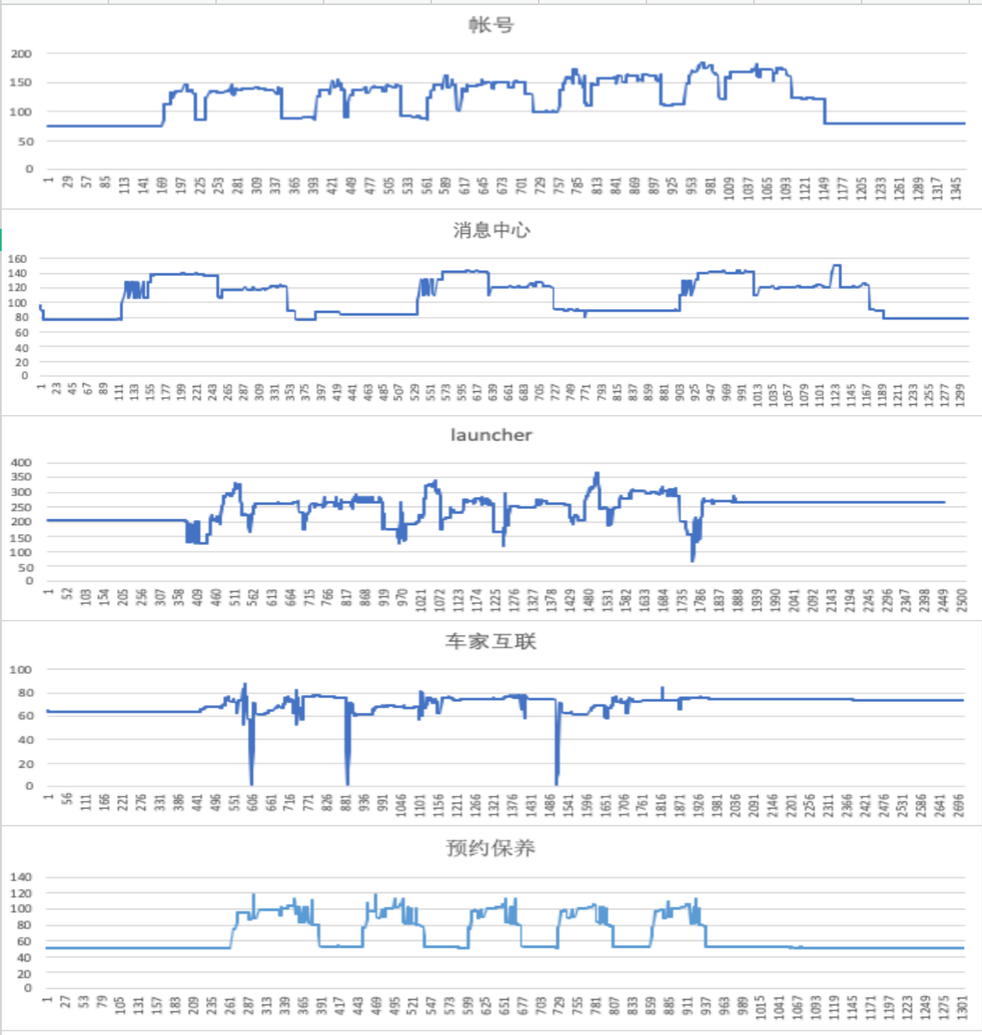
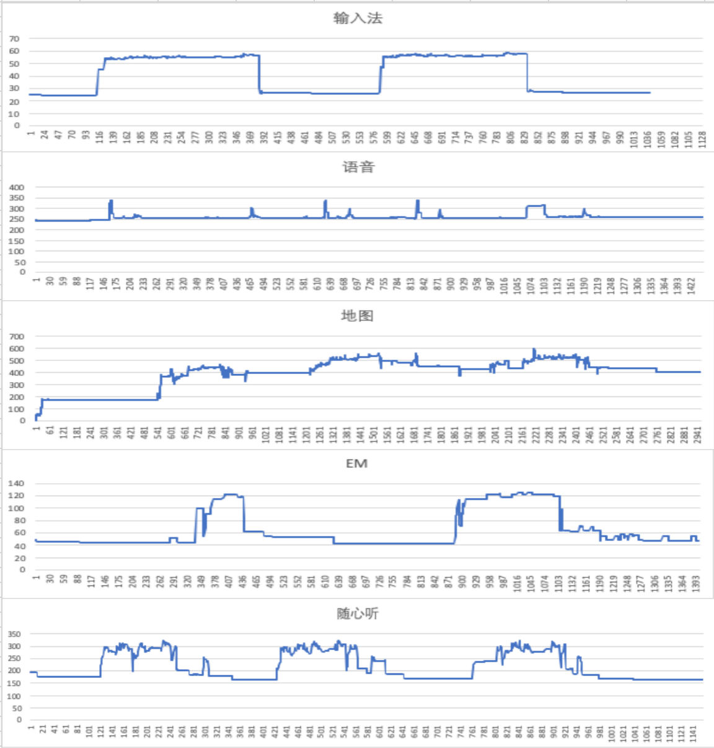
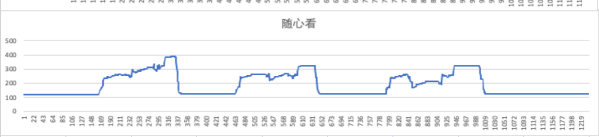
{MY23 U554_R05 HF1} 内存泄漏专项测试

Slide 5
{MY23 U554_R05 HF1} 语音专项测试
唤醒词唤醒率： Pass
唤醒词唤醒率
AI能力 | 指标项 | 通过标准 | 实测结果 | 测试结论
小度小度 | 低噪 | 92% | 100% | PASS
 | 中噪 | 90% | 99% | PASS
 | 高噪 | 85% | 98% | PASS
你好福特 | 低噪 | 92% | 100% | PASS
 | 中噪 | 90% | 100% | PASS
 | 高噪 | 85% | 99% | PASS
场景化命令词识别率
AI能力 | 指标项 | 通过标准 | 实测结果 | 测试结论
暂停播放 | 低噪 | 85% | 100% | PASS
 | 中噪 | 85% | 99% | PASS
 | 高噪 | 80% | 95% | PASS
继续播放 | 低噪 | 85% | 100% | PASS
 | 中噪 | 85% | 100% | PASS
 | 高噪 | 80% | 100% | PASS
上一首 | 低噪 | 85% | 99% | PASS
 | 中噪 | 85% | 98% | PASS
 | 高噪 | 80% | 100% | PASS
上一曲 | 低噪 | 85% | 96% | PASS
 | 中噪 | 85% | 96% | PASS
 | 高噪 | 80% | 88% | PASS
下一首 | 低噪 | 85% | 90% | PASS
 | 中噪 | 85% | 94% | PASS
 | 高噪 | 80% | 89% | PASS
下一曲 | 低噪 | 85% | 96% | PASS
 | 中噪 | 85% | 95% | PASS
 | 高噪 | 80% | 96% | PASS
接听电话 | 低噪 | 85% | 100% | PASS
 | 中噪 | 85% | 99% | PASS
 | 高噪 | 84% | 98% | PASS
挂断电话 | 低噪 | 84% | 99% | PASS
 | 中噪 | 84% | 100% | PASS
 | 高噪 | 84% | 98% | PASS
场景化命令词识别率
AI能力 | 指标项 | 通过标准 | 实测结果 | 测试结论
跟随模式 | 低噪 | 85% | 100% | PASS
 | 中噪 | 85% | 100% | PASS
 | 高噪 | 80% | 98% | PASS
车头朝上 | 低噪 | 85% | 100% | PASS
 | 中噪 | 85% | 99% | PASS
 | 高噪 | 80% | 95% | PASS
正北模式 | 低噪 | 85% | 99% | PASS
 | 中噪 | 85% | 96% | PASS
 | 高噪 | 80% | 96% | PASS
放大地图 | 低噪 | 85% | 100% | PASS
 | 中噪 | 85% | 98% | PASS
 | 高噪 | 80% | 98% | PASS
缩小地图 | 低噪 | 85% | 100% | PASS
 | 中噪 | 85% | 100% | PASS
 | 高噪 | 80% | 99% | PASS
打开路况 | 低噪 | 85% | 100% | PASS
 | 中噪 | 85% | 100% | PASS
 | 高噪 | 80% | 99% | PASS
关闭路况 | 低噪 | 85% | 99% | PASS
 | 中噪 | 85% | 100% | PASS
 | 高噪 | 80% | 100% | PASS
开始导航 | 低噪 | 85% | 100% | PASS
 | 中噪 | 85% | 95% | PASS
 | 高噪 | 80% | 90% | PASS
场景化命令词识别率
AI能力 | 指标项 | 通过标准 | 实测结果 | 测试结论
查看全程 | 低噪 | 85% | 100% | PASS
 | 中噪 | 85% | 100% | PASS
 | 高噪 | 80% | 98% | PASS
继续导航 | 低噪 | 85% | 99% | PASS
 | 中噪 | 85% | 100% | PASS
 | 高噪 | 80% | 98% | PASS
上一页 | 低噪 | 85% | 98% | PASS
 | 中噪 | 85% | 95% | PASS
 | 高噪 | 80% | 89% | PASS
下一页 | 低噪 | 85% | 100% | PASS
 | 中噪 | 85% | 100% | PASS
 | 高噪 | 80% | 95% | PASS
确定 | 低噪 | 85% | 100% | PASS
 | 中噪 | 85% | 96% | PASS
 | 高噪 | 80% | 91% | PASS
取消 | 低噪 | 85% | 100% | PASS
 | 中噪 | 85% | 98% | PASS
 | 高噪 | 80% | 100% | PASS
第一个 | 低噪 | 85% | 100% | PASS
 | 中噪 | 85% | 94% | PASS
 | 高噪 | 80% | 99% | PASS
第二个 | 低噪 | 85% | 100% | PASS
 | 中噪 | 85% | 100% | PASS
 | 高噪 | 80% | 100% | PASS
第三个 | 低噪 | 85% | 99% | PASS
 | 中噪 | 85% | 100% | PASS
 | 高噪 | 80% | 99% | PASS

Slide 6
{MY23 U554_R05 HF1} 语音专项测试
误唤醒测试：Pass
AI能力 | 测试时长 | 通过标准 | 实测结果 | 测试结论
小度小度 | 测试场景/时长 | <0.3次/h | 0 | PASS
你好福特 | 静态测试 | <1.2次/h | 0 | PASS
小度小度 | （互相聊天对话）4小时 | <0.3次/h | 0 | PASS
你好福特 | 播放爱情公寓5 | <1.2次/h | 0 | PASS

Slide 7
{MY23 U554_R05 HF1} 性能测试
序号 | 影响因素 | Target | R05 | R10（MY22 U554) | 偏差 | 百度Comments
1 | Power on QQ音乐首次启动 | 4 | 6.805333333 | NA | NA
2 | Power onQQ音乐选择歌单 | 1.5 | 2.581333333 | NA | NA
3 | Power onQQ音乐选择歌曲 | 1.5 | 2.74 | NA | NA
4 | Power onPTT可用 | 16 | 12.44466667 | 12.164 | 2.31%
5 | Power on语音可用 | 16.5 | 9.665333333 | 13.078 | -26.09%
6 | Power on语音播放音乐 | 5 | 9.525666667 | 28.00333333 | -65.98%
7 | Power onFM/在线电台音源恢复 | 0.5 | 3.236 | 2.789666667 | 16% | 正常偏差范围之内
8 | Power on到根目录两首歌的USB音源恢复 | 3.5 | 0.563733333 | 3.063 | -81.6%
9 | Power onQQ音源恢复 | 4 | 2.365666667 | 8.669666667 | -72.71%
10 | CPU常用场景一下归一化CPU Free | NA | 343 | NA | NA
11 | CPU常用场景二下归一化CPU Free | NA | 286 | NA | NA
12 | CPU常用场景三下归一化CPU Free | NA | 269.6 | NA | NA
13 | CPU Worst case下归一化CPU Free | NA | 308.8 | NA | NA
14 | RAM常用场景一下归一化RAM Free | NA | 73180 | NA | NA
15 | RAM Worst case下归一化RAM Free | NA | 697577.4 | NA | NA
16 | GPU常用场景一下归一化GPU Free | NA | 0.133333333 | NA | NA
17 | GPU常用场景二下归一化GPU Free | NA | 0.163333333 | NA | NA
18 | GPU常用场景三下归一化GPU Free | NA | 0.21 | NA | NA
19 | 系统稳定状态下QQ音乐首次启动 | 2.5 | 1.792 | 1.282 | 39.78% | 已达到Target（R07优化）
20 | 系统稳定状态下QQ音乐选择歌单 | 1.5 | 1.549333333 | 1.659666667 | -6.65%
21 | 系统稳定状态下QQ音乐选择歌曲 | 1.5 | 1.827666667 | 1.883 | -2.94%
22 | 系统稳定状态下USB音乐首次启动 | 2.2 | 2.127333333 | 1.659666667 | 28.18% | 已达到Target（跟U盘存放歌曲数量有关，暂不影响发版）
23 | 系统稳定状态下喜马拉雅首次启动 | 3.3 | 1.493333333 | 1.413 | 5.69%
24 | QQ/新闻/喜马拉雅/在线FM热启动 | NA | 1.05 | 1.313 | -20.03%
25 | USB音乐热启动 | 1 | 1.114 | 1.497 | -25.58%
26 | IVI路测常用场景1H后开启后倒车 | 1.5 | 1.525333333 | 1.333333333 | 14.4%
27 | 系统稳定状态下在线QQ音乐切歌 | 0.8 | 0.912 | 0.668333333 | 36.46% | 偏差较小，可忽略
28 | 系统稳定状态下在线电台切换/FM | 0.53 | 0.687333333 | 0.704666667 | -2.46%
29 | 系统稳定下，语音播放音乐 | 6.5 | 9.525666667 | NA | NA

Slide 8
{MY23 U554_R05 HF1} 性能测试
序号 | 影响因素 | Target | R05 | R10（MY22 U554) | 偏差 | 百度Comments
30 | 系统稳定下，语音车控 | 2.6 | 1.039 | NA | NA
31 | 系统稳定下，语音系统控制 | 0.8 | 0.383 | NA | NA
32 | Power on到账号自动登录时间 | 1 | 9.211333333 | NA | NA
33 | Power on到账号二维码出现时间 | 1.5 | 2.760333333 | NA | NA
34 | 语音热启动时间 | 1.2 | 1.141666667 | 1.485 | -23.12%
35 | 车机管家冷启动时间 | 2 | 1.040333333 | 1.62 | -35.78%
36 | 车机管家热启动时间 | 0.7 | 0.508666667 | 0.809 | -37.12%
37 | 消息中心冷启动时间 | 0.6 | 2.767333333 | 2.52 | 9.81%
38 | 消息中心热启动时间 | 0.45 | 0.755333333 | 0.744 | 1.52%
39 | 随心看冷启动时间 | 5 | 7.417666667 | 7.7 | -3.67% | R07优化
40 | 随心看热启动时间 | 0.6 | 2.901333333 | 2.789 | 4.03%
41 | 车家互联冷启动时间 | 3 | 2.476666667 | 3.1 | -20.11%
42 | 车家互联热启动时间 | 1 | 0.944333333 | 1.69 | -44.12%
43 | 预约保养冷启动时间 | 3.4 | 3.434666667 | 3.7 | -7.17%
44 | 预约保养热启动时间 | 0.2 | 0.526666667 | 0.56 | -5.95%
45 | 账号冷启动时间 | 0.6 | 1.001666667 | 1.4 | -28.45%
46 | 账号热启动时间 | 0.2 | 0.632 | 1.2 | -47.33%
47 | 输入法冷启动时间 | 2 | 1.160333333 | 2.1 | -44.75%
48 | 输入法热启动时间 | 1.5 | 0.94 | 1.13 | -16.81%
49 | EM冷启动时间 | 3 | 1.392333333 | 1.2 | 16.03%
50 | EM热启动时间 | 1 | 0.68 | 0.5 | 36% | 偏差较小，可接受范围之内
51 | 电影票冷启动时间 | 4 | 5.098 | 5.1 | -0.04%
52 | 电影票热启动时间 | 1 | 1.135333333 | 1.2 | 9.16%
53 | 智慧停车场冷启动时间 | 4 | 4.694 | 4.3 | 4.85%
54 | 智慧停车场热启动时间 | 1 | 1.677666667 | 1.6 | 4.85%
55 | 外卖冷启动时间 | 4 | 5.865 | 5.176667 | 13.3%
56 | 外卖热启动时间 | 1 | 1.974666667 | 2.7 | -26.86%
57 | 酒店预定冷启动时间 | 4 | 6.181 | 6.2123 | -0.5%
58 | 酒店预定热启动时间 | 1 | 2.034333333 | 2.323 | -12.43%

